Slide 1
A New Approach to Use Big Data Tools to Substitute Unstructured Data Warehouse
2020 IEEE Conference on Big Data and Analytics (ICBDA)
School of Computing, Southern Institute of Technology Invercargill, New Zealand
Author: Oras Baker, Chuong Nguyen Thien
Presenter : 李冠宏

Slide 2
Outline
Abstract
Introduction
Related works
Proposed system
Database design
Test method
Implementation and result
Conclusion

Slide 3
Outline
Abstract
Introduction
Related works
Proposed system
Database design
Test method
Implementation and result
Conclusion

Slide 4
Abstract
Data warehouse and big data have become the trend to help organize data effectively. Business data are originating in various kinds of sources with different forms from conventional structured data to unstructured data, it is the input for producing useful information essential for business sustainability.
In this research, we utilized the IBM BigInsights Text Analytics, PostgreSQL, and Pentaho tools, an unstructured data warehouse is implemented and worked excellently with the unstructured text from Amazon review datasets, the new proposed approach creates a practical solution for building an unstructured data warehouse.
Notes:
資料倉庫和大數據目前已經成為有效幫助組織資料的趨勢。 而商業的資料源於各種不同形式的來源，從傳統的結構化資料到非結構化資料，它是產生對商業可持續發展性至關重要之有用資訊的輸入。 本文利用了 IBM BigInsights 文字分析、PostgreSQL 和 Pentaho 工具，實作了一個非結構化資料倉庫，並與來自亞馬遜評論資料集的非結構化文字協同工作的效果很好，而新提出的方法為建構非結構化資料倉庫創造了一個實用的解決方案 .

Slide 5
Outline
Abstract
Introduction
Related works
Proposed system
Database design
Test method
Implementation and result
Conclusion

Slide 6
Introduction
Conventional structured data : details of employees stored in relational databases
Unstructured data : like emails or text documents
Most of the data is unstructured data, which occupies about 80 percent of an enterprise’s data
As more and more enterprises recognize the values and advantages associated with big data insights, the adoption of big data tools like Hadoop ecosystem is growing.
Notes:
資料的分類大約分成兩種
傳統的結構化資料：像是儲存在關聯式資料庫的員工詳細資料
非結構化資料：像是電子郵件或文字檔
大多數的資料都是非結構化資料，在企業中，非結構化資料大約佔了80% 隨著越來越多的企業認知到與大數據洞察力相關的價值和優勢，Hadoop 生態系統等大數據工具的採用正在增長。

Slide 7
Introduction
The aim of this research is to propose a solution for building an unstructured data warehouse with big data tools and to demonstrate that traditional data warehouses can support unstructured data by an intermediate phase to convert unstructured data to structured data before it is loaded into data warehouses.
With the help of this method, organizations can still use their current data warehouses with an additional component to support unstructured data.
Notes:
本研究的目的是提出一種使用大數據工具建構非結構化資料倉庫的解決方案，並演示傳統資料倉庫可以透過中間階段支援非結構化資料，且在非結構化資料加載到資料倉庫之前將其轉換為結構化資料。
在這種方法的幫助下，企業組織仍然可以使用他們當前的資料倉庫，並且有一個額外的組件來支持非結構化資料。

Slide 8
Outline
Abstract
Introduction
Related works
Proposed system
Database design
Test method
Implementation and result
Conclusion

Slide 9
Related works
[3] : Gupta and Rathore summarized the challenges to deal with unstructured data
[4] : Text mining, information retrieval, and information extraction
[5] : Text mining and natural language processing (NLP) are two techniques for knowledge discovery from textual context
[6] : Prasad and Ramakrishna examined various text analytics techniques to process text documents.
[3] Gupta, V., & Rathore, N. (2013). Deriving Business Intelligence from Unstructured Data. International Journal of Information and Computation Technology, 3(9), 971-976.
[4] Gonzalez, S. M., & Berbel, T. d. (2014). Considering unstructured data for OLAP: a feasibility study using a systematic review. Salesian Journal on Information Systems, 14, 26-35.
[5] Gharehchopogh, F. S., & Khalifelu, Z. A. (2011). Analysis and Evaluation of Unstructured Data: Text Mining versus Natural Language Processing. 2011 5th International Conference on Application of Information and Communication Technologies (AICT) (pp. 1-4). IEEE.
[6] Prasad, K. S., & Ramakrishna, S. (2010). Text Analytics to Data Warehousing. International Journal on Computer Science and Engineering (IJCSE), 02(06), 2201-2207.
Notes:
[3]：Gupta 和 Rathore 總結了處理非結構化資料的挑戰
[4]：文字探勘、資訊檢索、資訊提取
[5]：文字探勘和自然語言處理（NLP）是從文字上下文中發現觀念的兩種技術
[6]：Prasad 和 Ramakrishna 檢查了各種文字分析技術來處理文字檔。

Slide 10
Related works
[7] : Sukumaran and Sureka indicated that the named entity extraction technique has been a research topic for many years
[8] : Gupta discussed the deriving facts and dimensions from unstructured data
[9] : Alqarni and Pardede proposed using WordNet, a large lexical database of English
[10] : Tekadpande and Deshpande proposed a system with the ETL process in Hive and traditional dimensional modelling in Hadoop.
[7] Sukumaran, S., & Sureka, A. (2006). Integrating structured and unstructured data using text tagging and annotation. Business Intelligence Journal, 11(2), 8-17.
[8] Gupta, V. (2013). Extracting Facts And Dimensions From Unstructured Data For Business Intelligence. International Journal of Engineering Research & Technology (IJERT), 2(7), 2602-2606.
[9] Alqarni, A. A., & Pardede, E. (2012). Integration of data warehouse and unstructured business documents. 2012 15th International Conference on Network-Based Information Systems (pp. 32-37). IEEE.
[10] Tekadpande,S.,&Deshpande,L.(2015).AnalysisandDesignofETL process using Hadoop. International Journal of Engineering and Innovative Technology (IJEIT), 4(12), 171-174.
Notes:
[7]：Sukumaran 和 Sureka 表示，命名實體提取技術多年來一直是一個研究課題
[8]：Gupta 討論了從非結構化資料中導出事實和維度
[9]：Alqarni 和 Pardede 提出使用大型英語詞彙資料庫 WordNet
[10]：Tekadpande 和 Deshpande 提出了一個系統，在 Hive 中使用 ETL 過程，在 Hadoop 中使用傳統的維度建模。

Slide 11
Related works
[10] : Tekadpande and Deshpande used the star schema for multidimensional modelling and different transformations such as filter, aggregations, and joins were carried out.
[11] : Sahiet and Asanka, proposed an approach to construct a data warehouse for unstructured data stored in NoSQL databases by supporting an ETL framework to extract, transform and load unstructured data from NoSQL databases to the traditional data warehouses.
[10] Tekadpande,S.,&Deshpande,L.(2015).AnalysisandDesignofETL process using Hadoop. International Journal of Engineering and Innovative Technology (IJEIT), 4(12), 171-174.
[11] Sahiet,D.,&Asanka,P.D.(2015).ETLframeworkdesignforNoSQL databases in dataware housing. International Journal of Research in Computer Applications and Robotics, 3(11), 67-75.
Notes:
[10]：Tekadpande 和 Deshpande 使用星型模式進行多維建模，並進行了過濾、聚合和連接等不同的轉換。
[11]：Sahiet 和 Asanka 提出了一種為儲存在 NoSQL 資料庫中的非結構化資料建構資料倉庫的方法，透過支援 ETL 框架從 NoSQL 資料庫中提取、轉換和加載非結構化資料到傳統資料倉庫。

Slide 12
Outline
Abstract
Introduction
Related works
Proposed system
Database design
Test method
Implementation and result
Conclusion

Slide 13
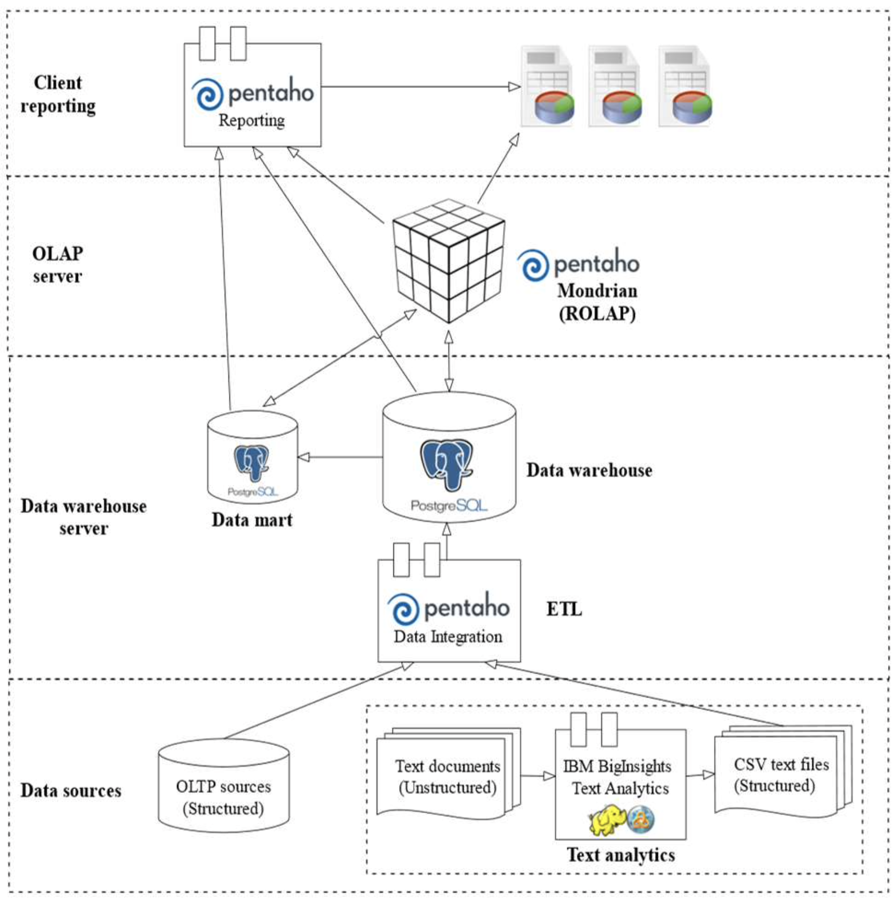
Proposed system
The proposed unstructured data warehouse follows the three-tier architecture.
Unstructured textual data will be handled first by the Text Analytics platform before its structured results are combined with other structured data sources to be loaded into data warehouse servers in the bottom tier by Pentaho Data Integration tool in ETL process. ETL tasks will help transform the input structured text to match with the multidimensional data design.
Notes:
本文提出的非結構化資料倉庫遵循三層架構。 在此設計中，IBM BigInsights 文字分析平台並不是替代，而是擴充了組織現有的傳統資料倉庫，使它們能夠從非結構化文字來源接收資料。
非結構化文字資料將首先由文字分析平台處理，然後將其結構化結果與其他結構化資料來源結合，透過 ETL 程序中的 Pentaho 資料整合工具加載到底層的資料倉庫伺服器。 ETL 任務將幫助轉換輸入的結構化文字以匹配多維資料設計。
ETL : Extract、Transformation、load

Slide 14
Proposed system
Online analytical processing (OLAP) server is implemented with Pentaho Mondrian located at the middle layer to support reporting and querying the data warehouse. The top tier is the frontend layer with Pentaho reporting tools integrated with the OLAP server or data warehouse servers to help users make various analytics reports.
Notes:
位於中間層的Pentaho Mondrian實現了線上分析處理（OLAP）伺服器，支援資料倉庫的報告和查詢。 頂層是前端層，Pentaho 報告工具與 OLAP 伺服器或資料倉庫服務器整合，以幫助用戶製作各種分析報告。

Slide 15
Proposed system
In order to import text documents into data warehouse, Text Analytics tool is used first to extract structured information from text documents to a Comma Separated Value (CSV) files, then Pentaho Data Integration tool is used to transform and load dimension data into data warehouse before fact data is transformed, mapped with dimension data and loaded into data warehouse.
Notes:
為了將文字檔導入資料倉庫，首先使用Text Analytics工具將文字檔中的結構化資訊提取為逗號分隔值（CSV）文件，然後在真實資料被轉換前，使用Pentaho Data Integration工具將維度資料轉換且映射並加載到資料倉庫中。

Slide 16
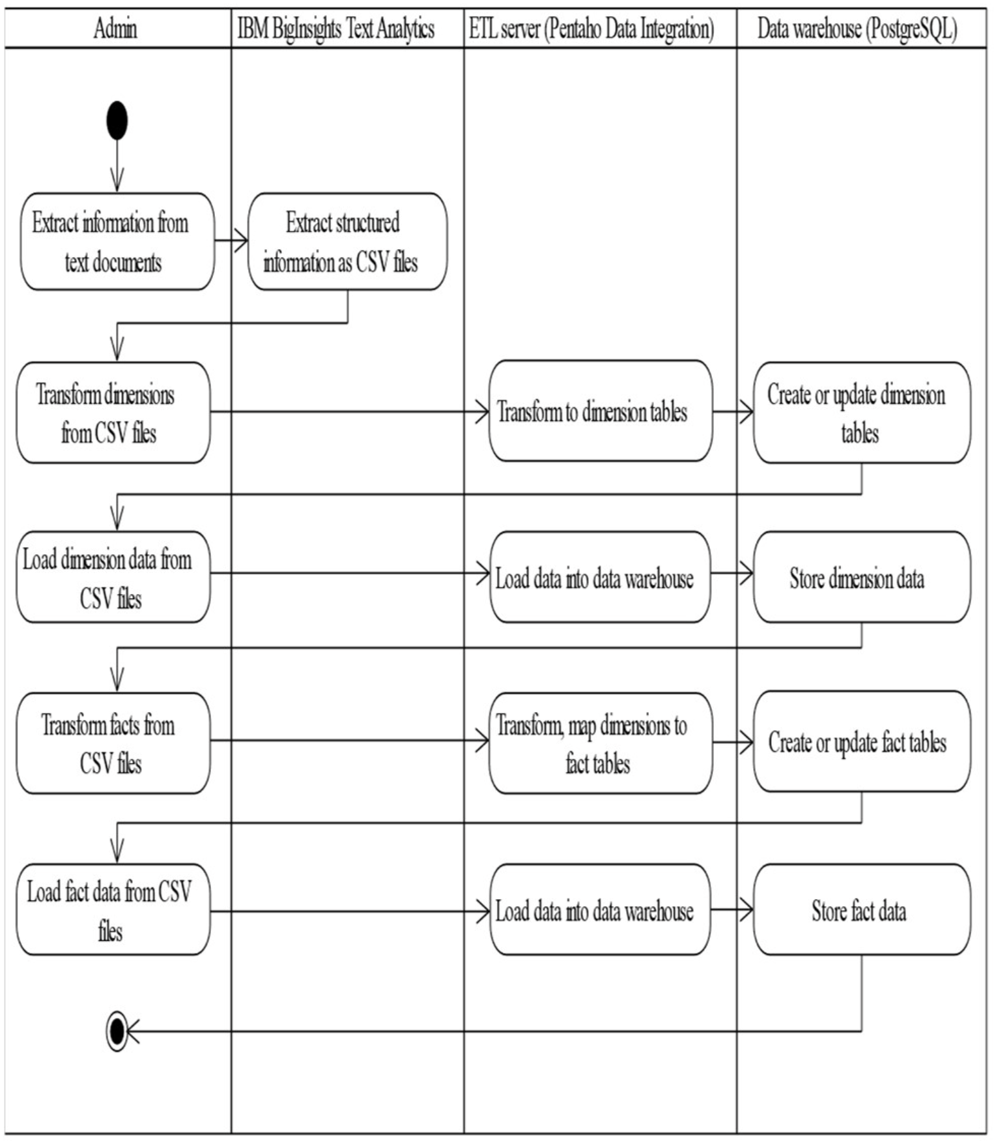
Proposed system
For new data import, new data tables for dimensions and facts will be created. For incremental data import, existing data tables of dimensions and facts will be updated or refreshed as shown in the activity diagram Fig. 2.
Notes:
對於新資料導入，它將創建包含維度和事實表格。而對於增量資料導入，維度和事實表格將被更新或刷新，如圖2的活動圖所示。

Slide 17
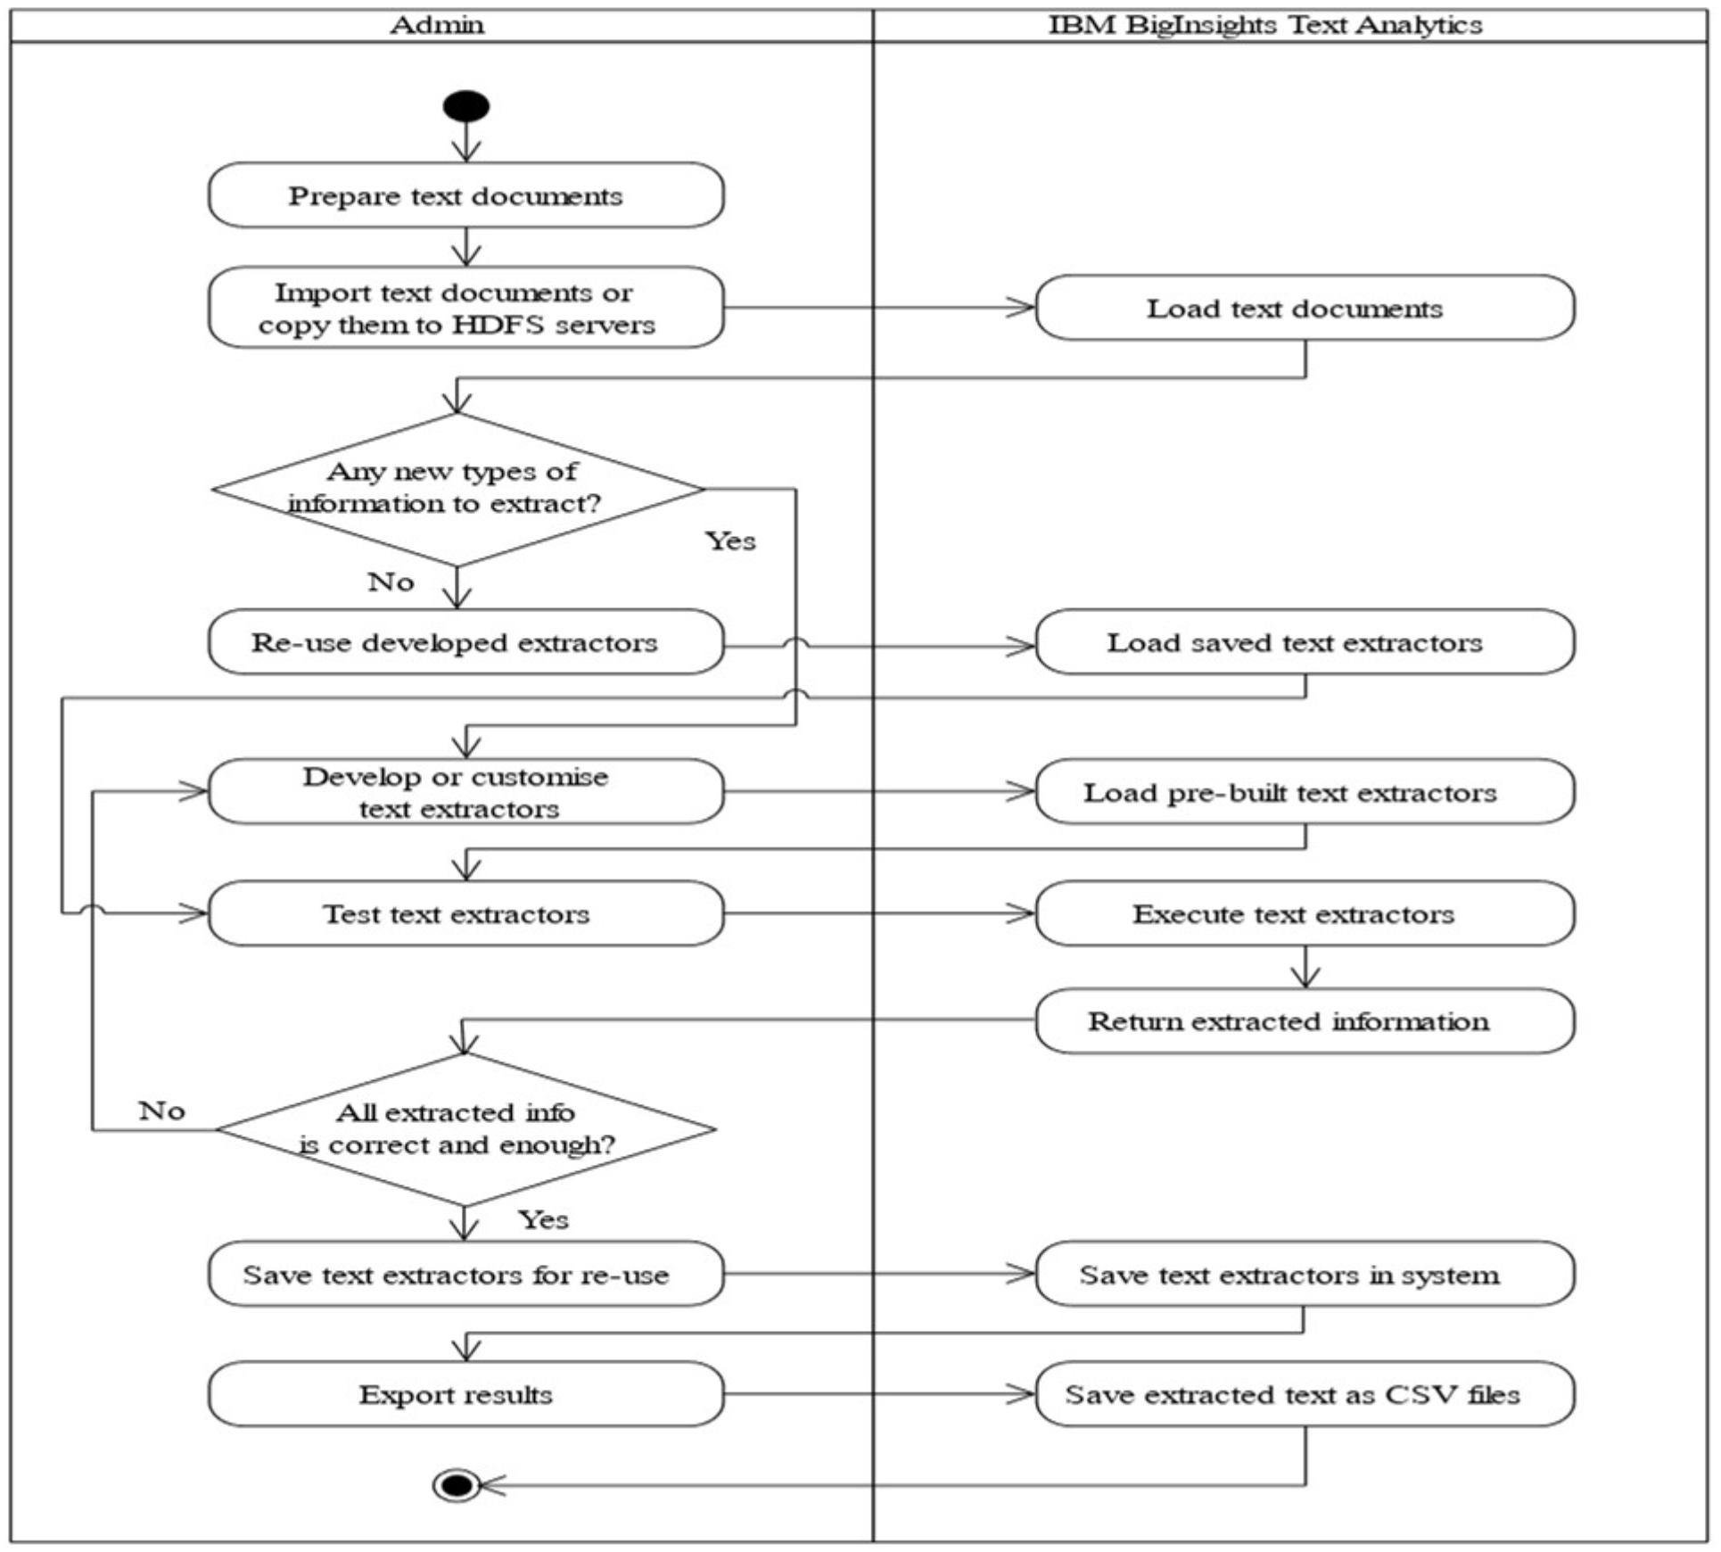
Proposed system
The process of extracting new text documents with incremental illustrated in Fig. 3. below show the detailed steps to extract new text documents that contain either new or existing types of information. The input files can be imported into Text Analytics web tool or put in HDFS servers. Users identify all the information to extract.
Notes:
右圖說明了使用增量提取新文字檔的過程。下面顯示了提取包含新資訊或現有類型資訊的新文字檔的詳細步驟。 輸入文件可以導入文字分析 web 工具或放在 HDFS (Hadoop distributed file system) 伺服器中。 用戶會識別要提取的所有資訊。

Slide 18
Proposed system
Amazon customer reviews dataset will be used for this experiment. As introduced in its documentation page [14] this public dataset is available for academic researches, especially with millions of customer reviews as a rich source of unstructured text data for text analytics in this research.
[14] Amazon. (n.d.). Amazon Customer Reviews Dataset.
Notes:
亞馬遜客戶評論資料集將用於此實驗。此公共資料集可用於學術研究，尤其是將數百萬客戶評論作為本研究中文字分析的非結構化文字資料是非常豐富的來源。

Slide 19
Outline
Abstract
Introduction
Related works
Proposed system
Database design
Test method
Implementation and result
Conclusion

Slide 20
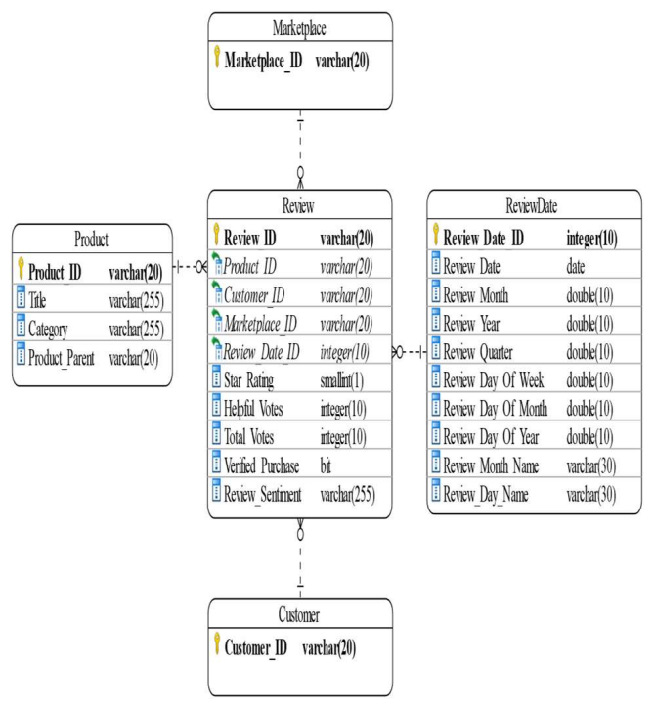
Database design
Data is designed with a multidimensional star schema as shown in Fig. 4. to support the multidimensional analytics reporting. Fact data is retrieved from the Text Analytics extractor results, and data for dimensions are extracted from the selected Amazon datasets.
Notes:
資料採用多維星型模式設計，如右圖所示，以支援多維分析報告。 事實資料是從文字分析提取器結果中檢索的，維度資料是從選定的 Amazon 資料集中提取的。

Slide 21
Database design
The review date is extracted along with the review data, then it is modelled in a separate time dimension with additional fields generated at the transformation step to help analyze review data with this time dimension from different perspectives.
Notes:
評論日期與評論資料一起提取，然後在單獨的時間維度中建模，並在轉換步驟中生成額外的字段，以幫助從不同角度分析具有該時間維度的評論資料。

Slide 22
Outline
Abstract
Introduction
Related works
Proposed system
Database design
Test method
Implementation and result
Conclusion

Slide 23
Test method
Testing will be conducted manually along with the implementation by verifying each phase output with the acceptance criteria:
Data extraction: Sample dataset files will be tamed by Text Analytics tool.
ETL process: Extracted text as CSV files will be transformed, cleansed and loaded into data warehouse.
Analytics reporting: OLAP cube can be created from data warehouse.
Notes:
本文透過使用驗收標準驗證每個階段的輸出，而測試將與實作一起手動進行：
資料提取：樣本資料集文件將被文字分析工具馴服。
ETL 程序：將提取的文字作為 CSV 文件進行轉換、清洗並加載到資料倉庫中。
分析報告：可以從資料倉庫創建 OLAP 多維資料集

Slide 24
Outline
Abstract
Introduction
Related works
Proposed system
Database design
Test method
Implementation and result
Conclusion

Slide 25
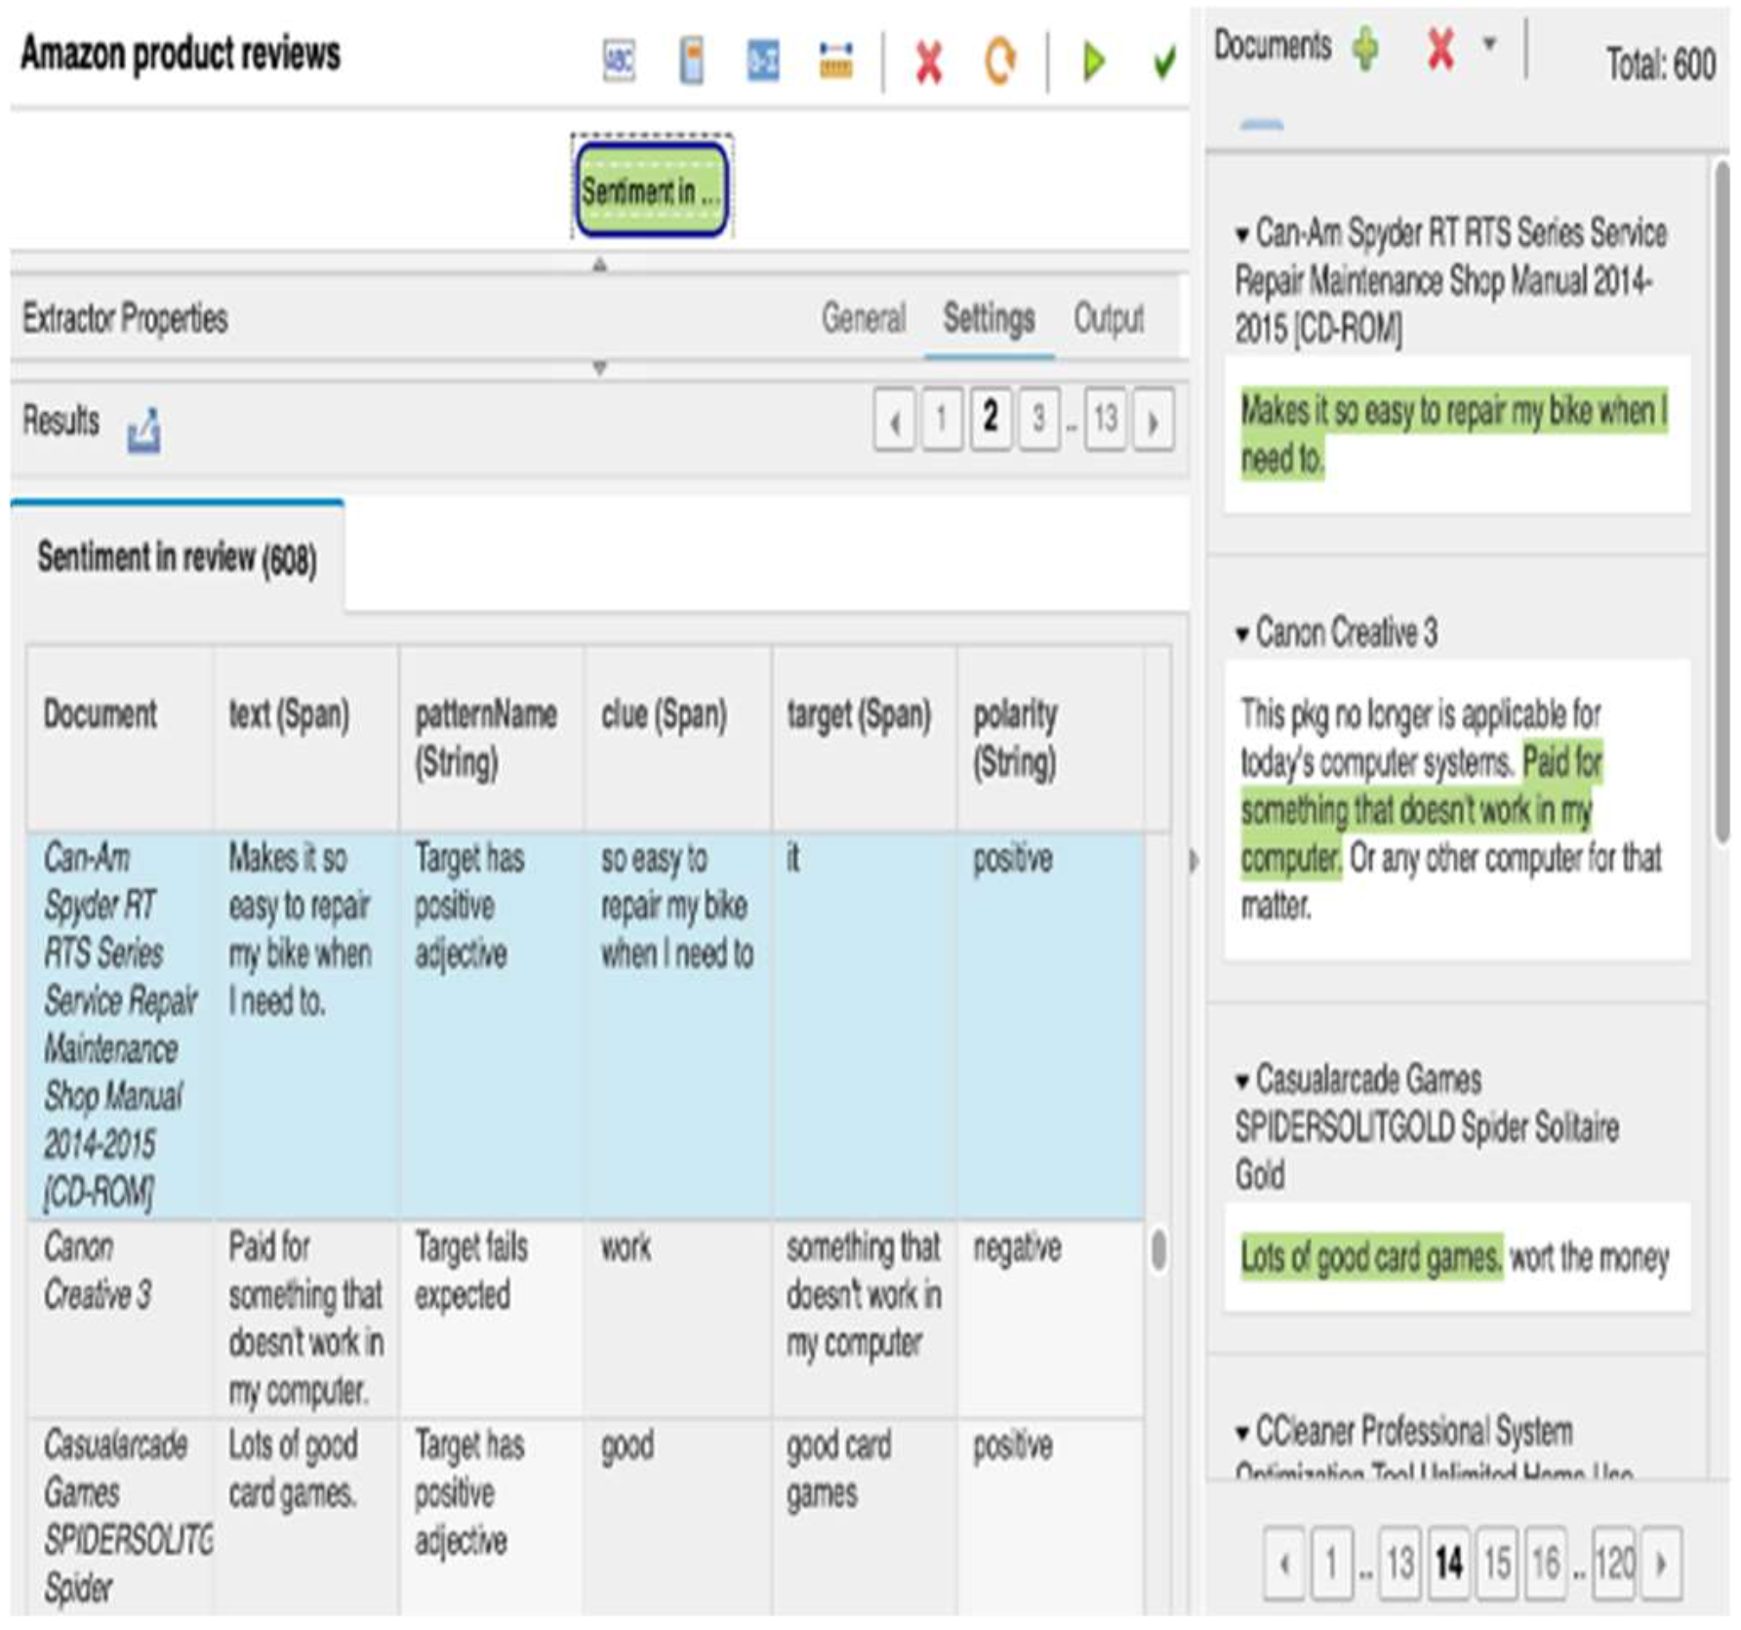
Implementation and result
The values in the polarity column, either positive or negative, are the sentiment of product review that will be used in data warehouse for analytics reporting. Other fields in results such as text, pattern name, clue, and target are the extra information to explain the extractor rules and how they run to determine the polarity results. They can be omitted in the exported results.
Notes:
極性列 (polarity) 中的值（正面或負面）是產品評論的情緒，將在資料倉庫中用於分析報告。 結果中的其他字段（例如文字、模式名稱、線索和目標）是解釋提取器規則以及它們如何運行以確定極性結果的額外信息。 在導出的結果中可以省略它們。
對於一些尚不准確的結果，提取器通過更新詞典進行重做，以實現更好的情感分析。 最終的提取器在 Hadoop 集群上針對儲存在 HDFS 伺服器器中的完整 Amazon 資料集進行保存和執行，可以直接在文字分析 Web 工具中調用。 然後從 HDFS 伺服器檢索結果文件作為 ETL 過程的輸入加載到資料倉庫中。

Slide 26
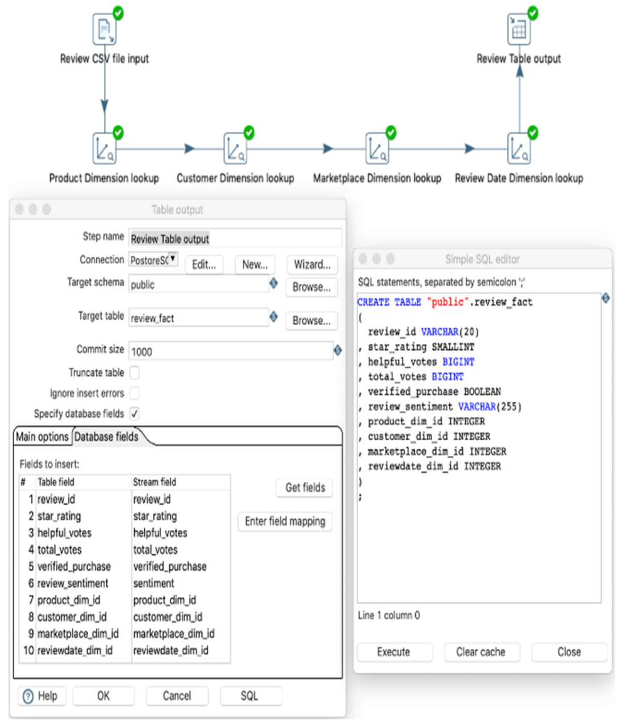
Implementation and result
This transformation starts with loading CSV file of the Review dataset including the review sentiment information extracted by Text Analytics before. Then the properties such as data type, format, length of all loaded fields need to be defined or adjusted accordingly to match with the datasets and designed database.
Notes:
Review 事實資料的轉換與維度的轉換非常相似，除了事實資料需要與其在前面的步驟中已經轉換並加載到資料庫中的維度相關聯。 還可以創建一些事實計算字段。
此轉換從加載評論資料集的 CSV 文件開始，其中包括之前由文字分析提取的評論情緒資訊。 然後需要相應地定義或調整所有加載字段的資料類型、格式、長度等屬性，以配對資料集和設計的資料庫。

Slide 27
Implementation and result
For mapping fact data with its dimensions in database, each related dimension such as product, customer, marketplace and review date are looked up and their keys are mapped.
At the last step, the suitable fields in the processing stream are selected for fact table before it is created in database by executing the generated SQL scripts.
Then the transformation is ready to run against different Review datasets of various product categories and marketplaces to load them into the database.
Notes:
為了將事實資料與其在資料庫中的維度進行映射，將會尋找每個相關維度，例如產品、客戶、市場和評論日期，並映射它們的鍵。
最後一步，在資料庫中，在執行生成的 SQL 腳本創建事實表之前，為事實表選擇處理流程中的合適字段。
然後，轉換準備好針對各種產品類別和市場的不同評論資料集運行，以將它們加載到資料庫中。

Slide 28
Implementation and result
There are few errors with some Amazon datasets when loading them into the data warehouse, such as invalid values in the marketplace, product title or review date, and some rows with missing columns.
The transformations would throw errors in these cases that could be fixed by correcting or cleaning the error data or updating the transformations like changing the mapping fields or fixing the data length.
Pentaho tool supports regenerating SQL update scripts as a hotfix for any database changes.
Notes:
一些亞馬遜資料集在加載到資料倉庫時幾乎沒有錯誤，例如市場中的無效值、產品標題或評論日期，以及一些列 缺少行。
在這些情況下，轉換會拋出錯誤，這些錯誤可以通過更正或清理錯誤資料或更新轉換（如更改映射字段或固定資料長度）來修復。
Pentaho 工具支援重新生成 SQL 更新腳本作為任何資料庫更改的修補程序。

Slide 29
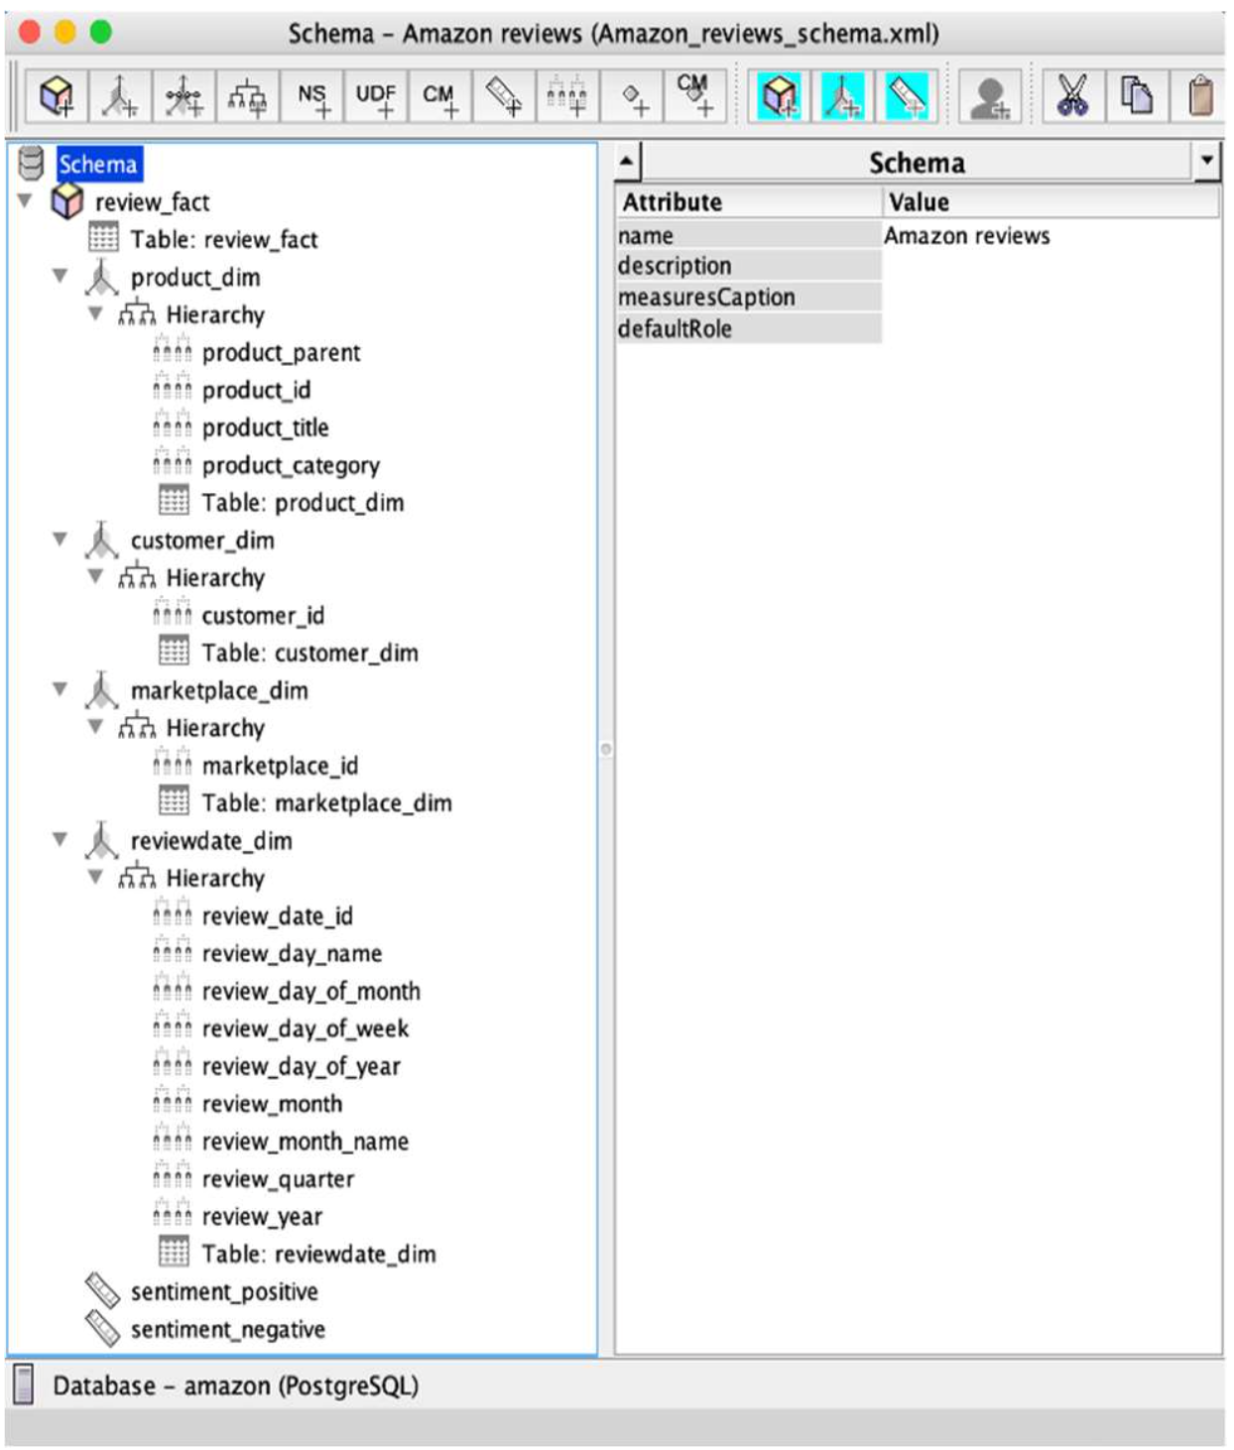
Implementation and result
For instance, the product review sentiment extracted by Text Analytics is analyzed from different dimensions and perspectives, useful for the management team to understand and improve their businesses. As in Fig. 7. Pentaho Schema Workbench tool is used for designing OLAP schema with its fact and dimensions similar to the schema in the data warehouse.
Notes:
例如，文字分析提取的產品評論情緒從不同的維度和角度進行分析，有助於管理團隊了解和改進他們的業務。 如右圖所示，Pentaho Schema Workbench 工具用於設計 OLAP 模式，其事實和維度類似於資料倉庫中的模式。

Slide 30
Implementation and result
The OLAP schema is a multi-level hierarchy in which the fact contains its dimensions. The review fact table is designed with 2 measures for positive and negative sentiments that will be aggregated in the reports. The schema defines the fields that can appear in the OLAP cube.
The review date dimension needs to be correctly marked as a time dimension. After the schema is completed, it is published to Pentaho Business Analytics server as a data source for making analytics reports.
Saiku Analytics tool, a popular plugin in Pentaho Business Analytics, is utilised in this experiment for working with OLAP reports. It can help create dashboards and MDX queries to display OLAP cube in tables or charts.
Notes:
OLAP schema是一個多級層次結構，其中事實包含其維度。 評論事實表設計有 2 個衡量正面和負面情緒的措施，這些措施將彙整在報告中。 schema 定義了可以出現在 OLAP 多維資料集中的字段。
審核日期維度需要正確標記為時間維度。而在 schema 完成後，會發佈到 Pentaho Business Analytics 伺服器，作為製作分析報告的資料源。
Saiku Analytics 工具是 Pentaho Business Analytics 中的一個流行插件，在本實驗中用於處理 OLAP 報告。 它可以幫助創建儀表板和 MDX (multidimensional expression) 查詢以在表格或圖表中顯示 OLAP 多維資料集。

Slide 31
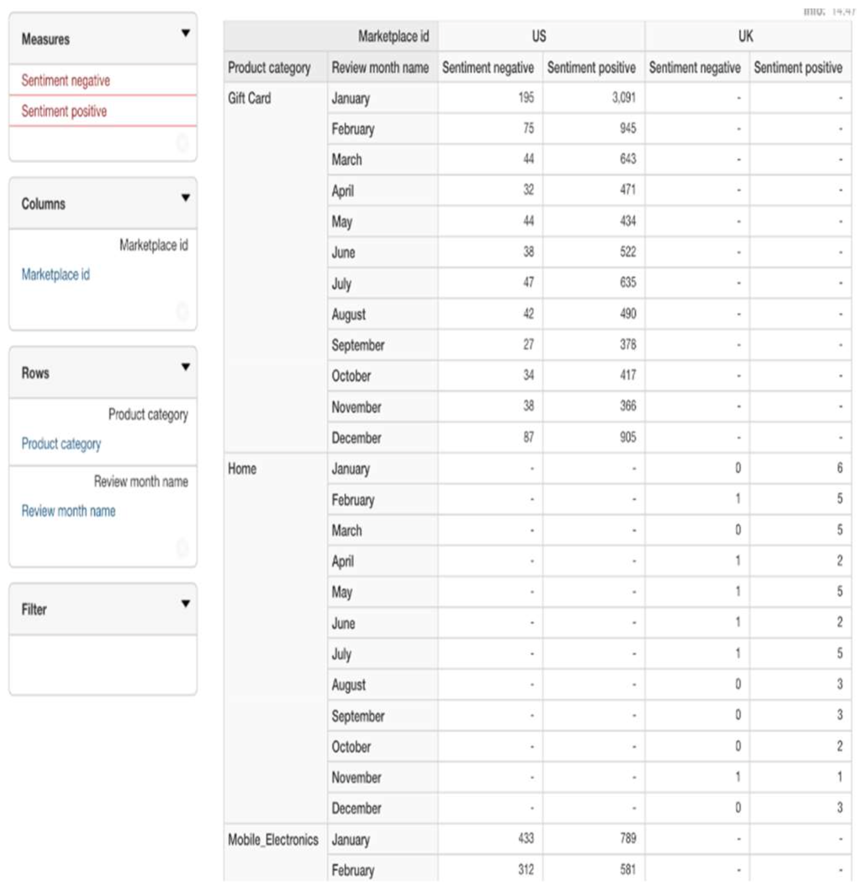
Implementation and result
Using Saiko analytics tools enabled creating dashboards IBM and MDX queries to display OLAP cube in tables or charts. The OLAP cube for Amazon review data in Fig 8. shows the sentiment measures with marketplace dimension in columns, and product category and month dimensions in rows.
Notes:
使用 Saiko 分析工具可以創建 IBM 儀表板和 MDX 查詢以在表格或圖表中顯示 OLAP 多維資料集。右圖中亞馬遜評論資料的 OLAP 多維資料集顯示了情緒度量，行中包含市場維度，列中包含產品類別和月份維度。

Slide 32
Outline
Abstract
Introduction
Related works
Proposed system
Database design
Test method
Implementation and result
Conclusion

Slide 33
Conclusion
The proposed solution is similar to the total data warehouse solution recommended by [3]. However, the suggested design of this research is further advanced by utilizing IBM BigInsights Text Analytics tool with hundreds of pre-built text annotators or extractors that make the text analytics work much simpler.
In the experiment, the extractor with sentiment analysis returned all correct results after being customized to extract review sentiment from Amazon datasets.
[3] Gupta, V., & Rathore, N. (2013). Deriving Business Intelligence from Unstructured Data. International Journal of Information and Computation Technology, 3(9), 971-976.
Notes:
本文所提出的解決方案類似於文獻 [3] 推薦的總體資料倉庫解決方案。 但是，透過使用 IBM BigInsights 文字分析工具和數百個預構建的文字註釋器或提取器，使文字分析工作變得更加簡單，從而進一步推進了這項研究的建議設計。
在實驗中，具有情感分析的提取器在定制後從亞馬遜資料集中提取評論情感後返回了所有正確的結果。

Slide 34
Conclusion
A forthcoming design should use big data tools to process, store and analyze the unstructured data completely as a data warehouse, so that the advanced design of big data tools can be utilized in the right place with greater outcomes.
However, it is challenging and takes significant effort to design and implement big data tools as a complete replacement for a data warehouse. Using them together like the current design is still a practical solution.
Notes:
未來的設計應該使用大數據工具，將非結構化資料完全作為資料倉庫進行處理、存儲和分析，這樣大數據工具的先進設計才能用在正確的地方，取得更好的成果。
然而，設計和實施大數據工具作為資料倉庫的完全替代品是具有挑戰性的，需要付出巨大的努力。 像當前的設計一樣，將它們一起使用仍然是一個實用的解決方案。

